Slide 1
Let’s learn SQL through Set Theory!
Part 1
Robed Beauvile 05/06/2020

Slide 2
So what is a Database?
Database is a systematic collection of data. They support storage and manipulation of data and they make data management quite easy.
A few examples would be:
Facebook, which needs to store, manipulate and present data related to members, their friends, member activities, messages, advertisements and lot more.
Your electricity service provider is obviously using a database to manage billing, to deal with client related issues, to handle fault data, etc.
Even the University of Pittsburgh has many databases like the University Library System ( ULS ). It contains a collection of articles, books, journals and even databases!

Slide 3
SQL
SQL stands for Structured Query Language
SQL is used to communicate with a database.
According to ANSI (American National Standards Institute), it is the standard language for relational database management systems.
Some common relational database management systems that use SQL are: MySQL, Oracle, PostgreSQL, Microsoft SQL Server etc.
SQL statements are used to perform tasks such as update data on a database, or retrieve data from a database.
Some of the standard SQL commands are "Select", “Insert", and "Create" which can be used to accomplish many things that one needs to do with a database.

Slide 4
Fundamentals in Set Theory
Empty set, it’s a collection of zero objects and you will find in some references, it’s also called the null set. Its notation is ∅ or { }.
A non-empty set contains one or more objects. This also means that a set can contain a set.
Set to set membership also known as subset relation or set inclusion.
Just like any arithmetic theory, set theory defines its own binary operations on sets. As an example, in number theory, we can find operations like addition or division.

Slide 5
Fundamentals in Set Theory cont…
Set theory begins with a fundamental binary relation between an object o and a set A. If o is a member (or element) of A, the notation o ∈ A is used.
If all the members of set A are also members of set B, then A is a subset of B, denoted A ⊆ B. For example, {1, 2} is a subset of {1, 2, 3} , and so is {2} but {1, 4} is not.
Union of the sets A and B, denoted A ∪ B, is the set of all objects that are a member of A, or B, or both. The union of {1, 2, 3} and {2, 3, 4} is the set {1, 2, 3, 4} .
Set difference of U and A, denoted U \ A, is the set of all members of U that are not members of A. The set difference {1, 2, 3} \ {2, 3, 4} is {1} , while, conversely, the set difference {2, 3, 4} \ {1, 2, 3} is {4} .
When A is a subset of U, the set difference U \ A is also called the complement of A in U. In this case, if the choice of U is clear from the context, the notation A^{c} is sometimes used instead of U \ A .

Slide 6
Fundamentals in Set Theory cont...
So the complement {1, 2, 3} \ {2, 3} is {1} , while, conversely, the set difference {2, 3} \ {1, 2, 3} is { } .
Cartesian product of A and B, denoted A × B, is the set whose members are all possible ordered pairs (a, b) where a is a member of A and b is a member of B.
The cartesian product of {1, 2} and $\{red,white\}$ is {(1, red), (1, white), (2, red), (2, white)}.
Furthermore, if we had 3 sets $A=${1, 2}, $B=\{red,white\}$, and $C=\{hot\}$ then $A×B×C$ = {(1, red , hot), (1, white, hot), (2, red, hot), (2, white, hot)}.
The Intersection of two sets contains the elements that the two sets have in common, $\{1,2,3\}∩\{1,2\}=\{1,2\}$.

Slide 7
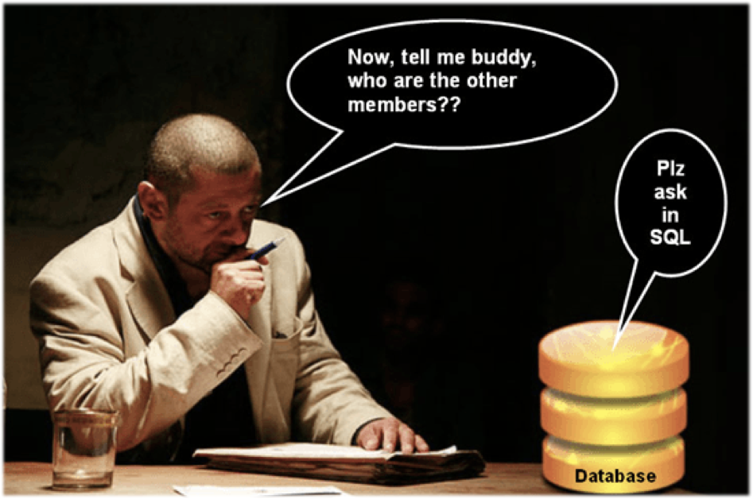
SQL commands are the instructions…
used to communicate with a database to perform tasks, functions, and queries with data.
Some commands we can use to communicate with a database:
CREATE TABLE
INSERT and VALUE
SELECT and FROM
WHERE
AS
ORDER BY
INNER JOIN
LEFT JOIN
RIGHT JOIN
FULL OUTER JOIN

Slide 8
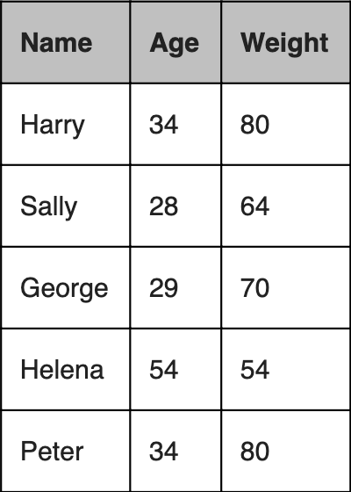
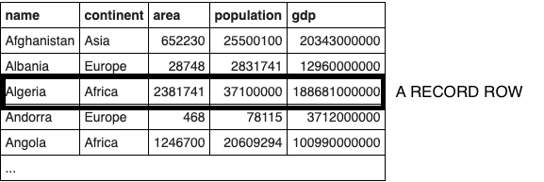
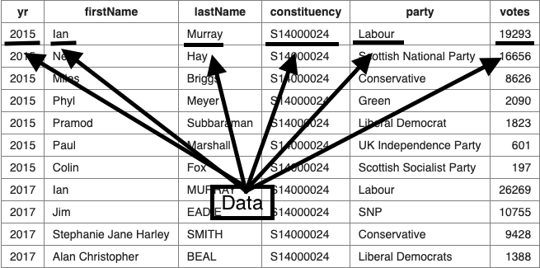
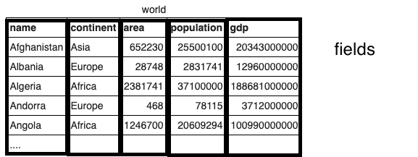
What is a Data Table?
Simply put… it’s a table of data.

Slide 9
What is a Data Table? Cont…
Note that a tuple is a finite ordered list (sequence) of elements.
An n-tuple is a sequence (or ordered list) of n elements, where n is a natural number, denoted as ℕ.
Mathematicians usually write 'tuples' by listing the elements within parentheses “( )” and separated by commas; for example, (5, 101, 6, 7, 1) denotes a 5-tuple.
Braces "{ }" are usually used in defining arrays in some programming languages such as C++ and Java, but not in mathematical expressions, as they are the standard notation for sets.
From here on out we will look at a DATA TABLE as a set of n-tuples or ROW RECORDS.

Slide 10
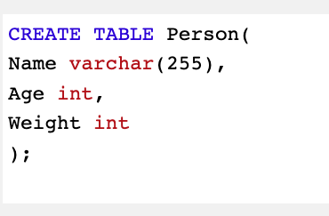
CREATE TABLE
CREATE TABLE does just what it sounds like: it creates a table in the database. You can specify the name of the table and the columns that should be in the table.
CREATE TABLE table_name (
column_name_1 datatype,
column_name_2 datatype,
column_name_3 datatype
.
.
.
column_name_($n$) datatype
);

Slide 11
INSERT and VALUES
INSERT INTO table_name (column1, column2, column3, …, column($n$))
VALUES (value1, value2, value3, …, value($n$));
FOR EXAMPLE:
INSERT INTO Person ( Name, Age, Weight )
VALUES ('Harry', 34, 80);
INSERT INTO Person ( Name, Age, Weight )
VALUES ('Sally', 28, 64);;
INSERT INTO Person ( Name, Age, Weight )
VALUES ('George', 29, 70);
INSERT INTO Person ( Name, Age, Weight )
VALUES ('Helena', 54, 54);
INSERT INTO Person ( Name, Age, Weight )
VALUES (‘Peter', 34, 80);
$⟵$ (Name, Age, Weight)
$⟵$ 3-tuple
$$⟵$$
$⟵$ 3-tuple
$⟵$ 3-tuple
$⟵$ 3-tuple
$⟵$ 3-tuple
Person
$⟵$ Set

Slide 12
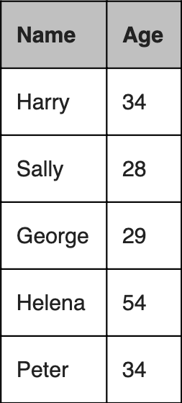
SELECT and FROM
The SELECT part of the command determines which columns of the DATA TABLE to show in the results.
The example shows two columns SELECTed FROM the “Person” table.
SELECT column1, column2, … column($n$)
FROM table_name
WHERE condition;
FOR EXAMPLE:
SELECT Name, Age FROM Person;

Slide 13
SELECT and FROM ( WHERE )
A selection ( sometimes called a restriction in reference to E.F. Codd's 1970 paper^{[1]}) is a unary operation that denotes a subset of a DATA TABLE.
A selection is written as $σ_{aθb}(R)$ or $σ_{aθν}(R)$ where:
a and b are attribute names
θ is a binary operation in the set $A=\{<,≤,=,≠,≥,>\}$
v is a value constant
$R$ is a DATA TABLE
The selection $σ_{aθb}(R)$ denotes all tuples in R WHERE θ holds between the a and the b attribute.
The selection $σ_{aθν}(R)$ denotes all tuples in R WHERE θ holds between the a attribute and the value v.

Slide 14
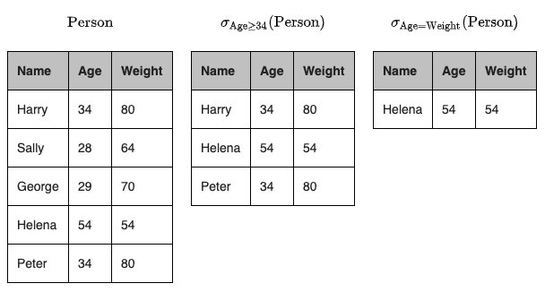
SELECT and FROM ( WHERE ) cont… example
$σ_{Age≥34}(Person)=\{(Name,Age,Weight)∈Person|Age≥34\}$
$$σ_{Age=Weight}(Person)=\{(Name,Age,Weight)∈Person|Age=Weight\}$$
For example, consider the following tables where the
First table gives the DATA TABLE Person,
The second table gives the result of $σ_{Age≥34}(Person)$.
The third table gives the result of $σ_{Age=Weight}(Person)$.

Slide 15
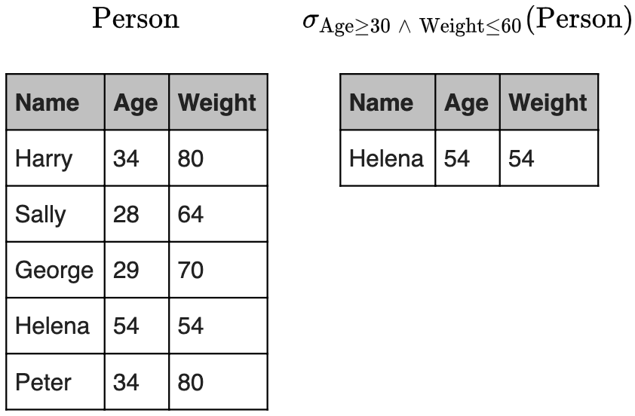
SELECT and FROM ( WHERE ) cont…
Generalized selection is a unary operation written as $σ_{φ}(R)$ where $φ$ is a propositional formula that consist of atoms and members of $A$ i.e. all operations with$\{∧(and),∨(or),¬(not)\}∪A$
This selection selects all those tuples in R for which $φ$ holds.
For an example, consider the following tables where the first table gives the Person table and the second the result of $σ_{Age≥30∧Weight≤60}(Person)$
Example

Slide 16
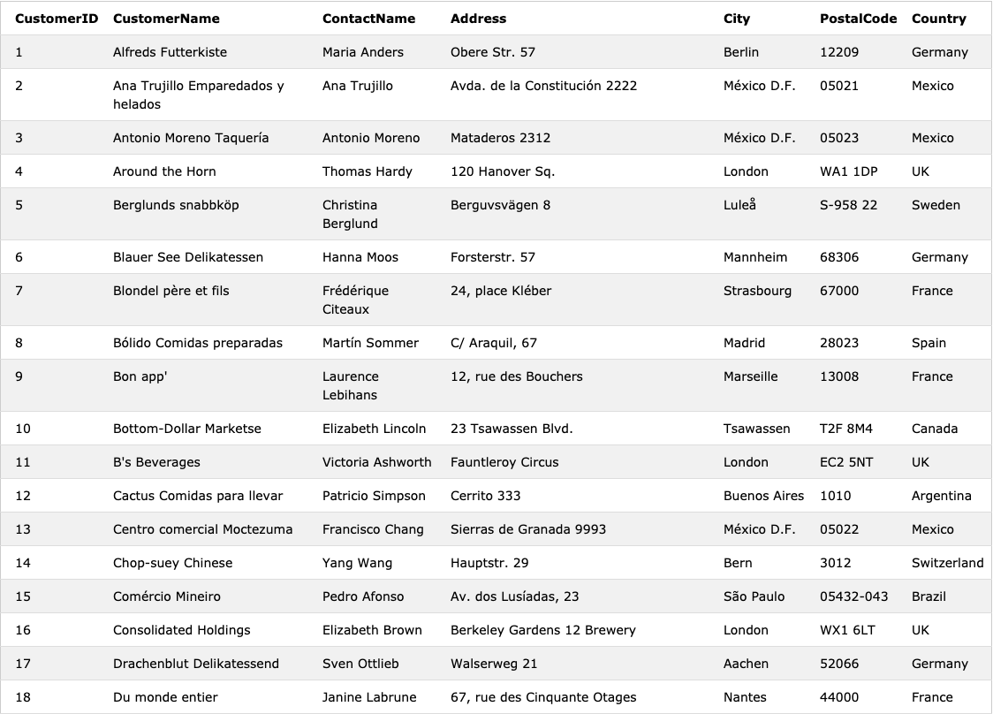
Customers

Slide 17
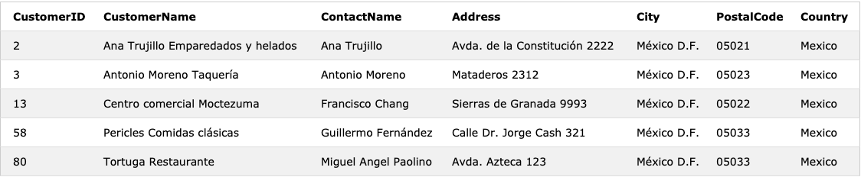
SELECT and FROM ( WHERE ) cont…
Another example using the commands
SELECT column1, column2, … column($n$)
FROM table_name
WHERE condition;
For example:
SELECT * FROM Customers WHERE Country = ‘Mexico’ ;

Slide 18
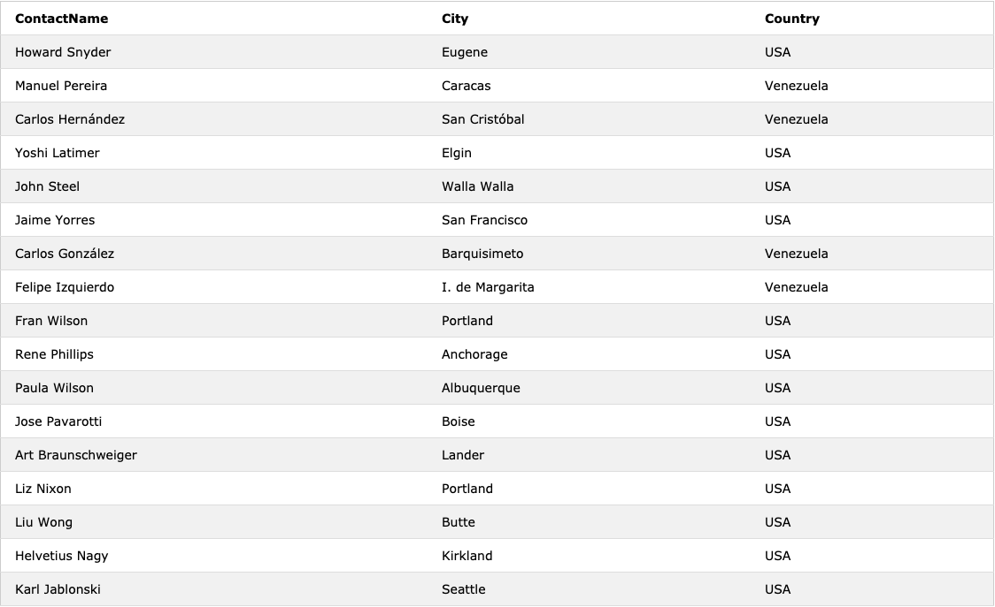
SELECT and FROM ( WHERE ) cont…
Another example using the commands cont…
SELECT ContactName, City, Country FROM Customers WHERE Country >= 'USA';

Slide 19
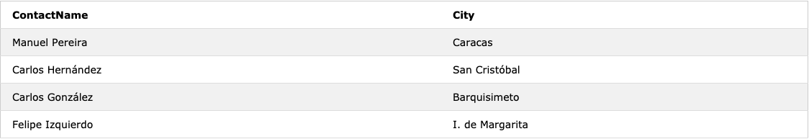
SELECT and FROM ( WHERE ) cont…
Another example using the commands cont…
SELECT ContactName, City FROM Customers WHERE Country > 'USA';

Slide 20
INNER JOIN (JOIN)
… and LEFT JOIN, RIGHT JOIN, FULL OUTER JOIN
JOIN, also called INNER JOIN, selects ROW RECORDS that have matching values in two tables depending on the fields.
A LEFT JOIN returns all rows from the left table, and the matched rows from the right table. Rows in the left table will be returned even if there was no match in the right table. The rows from the left table with no match in the right table will have NULL for right table values.
A RIGHT JOIN returns all rows from the right table, and the matched rows from the left table. This will return all rows from the right table even where there is no match in the left table. Rows in the right table that have no match in the left table will have NULL values for left table columns.
A FULL OUTER JOIN returns all rows for which there is a match in either of the tables. So if there are rows in the left table that do not have matches in the right table, those will be included. Also, if there are rows in the right table that do not have matches in the left table, those will be included.

Slide 21
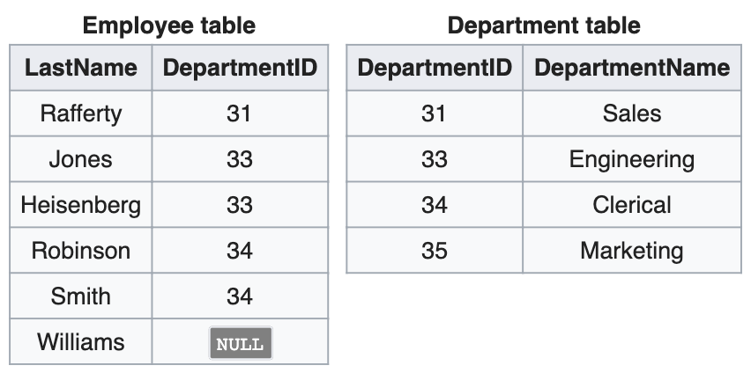
JOIN, Primary Key, and Foreign Key
In the following tables the DepartmentID column of the Department table (which can be designated as Department.DepartmentID) is the primary key, while Employee.DepartmentID is a foreign key.
Primary key - The primary key is defined as a column (or set of columns) where each value is unique and identifies a single row of the table.
Foreign key - A foreign key is a column or a set of columns in one table that references the primary key columns in another table
For example Employee.DepartmentID is a foreign key, any value existing as the number of department ID in Employee table must also exist as a department ID in the Department table

Slide 22
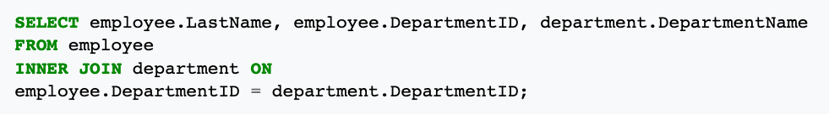
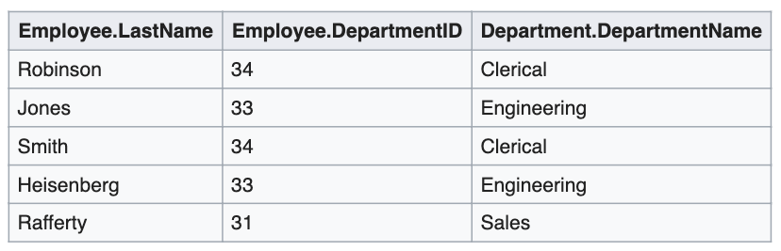
JOIN
$$(A∩B)$$

Slide 23
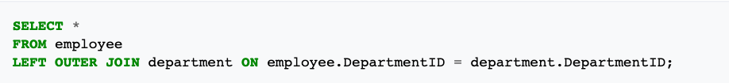
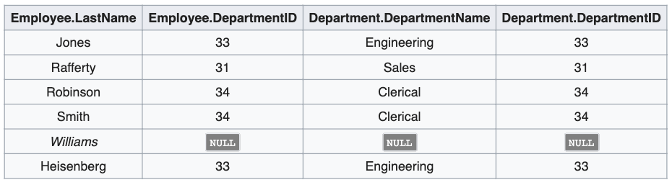
LEFT JOIN
$$A∪(A∩B)$$

Slide 24

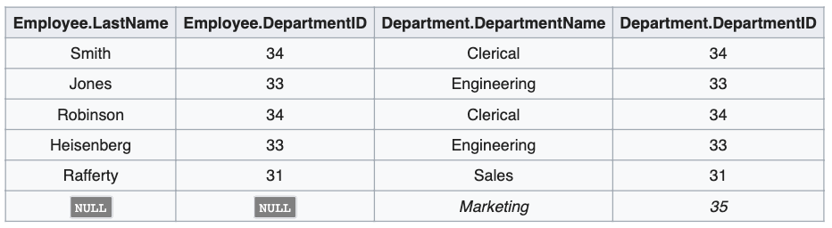
RIGHT JOIN
$$B∪(A∩B)$$

Slide 25

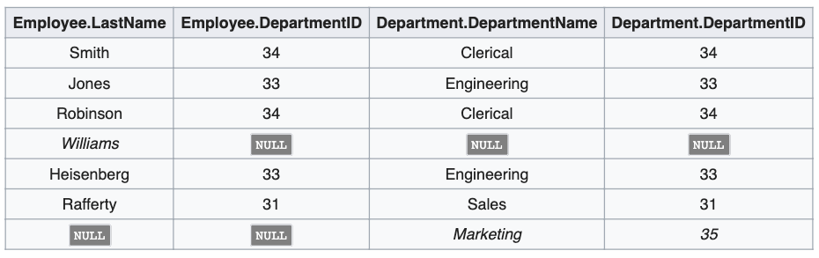
FULL OUTER JOIN
$$A∪B∪(A∩B)$$
$$A∪B$$

Slide 26
Thank You
Presentation from Robed Beauvile
05/06/2020

